Slide 1
Vim Editor and Simple Shell Script
Instructor: Li Feng
Capital University

Slide 2
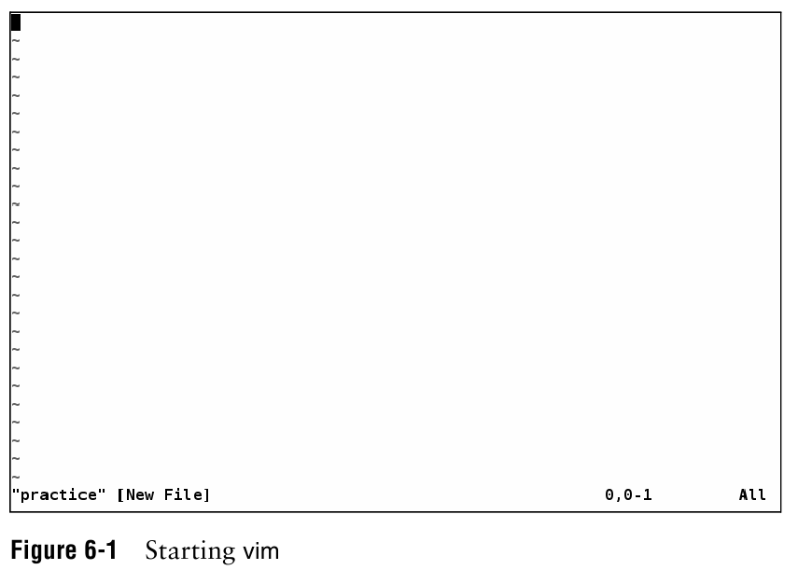

Slide 3
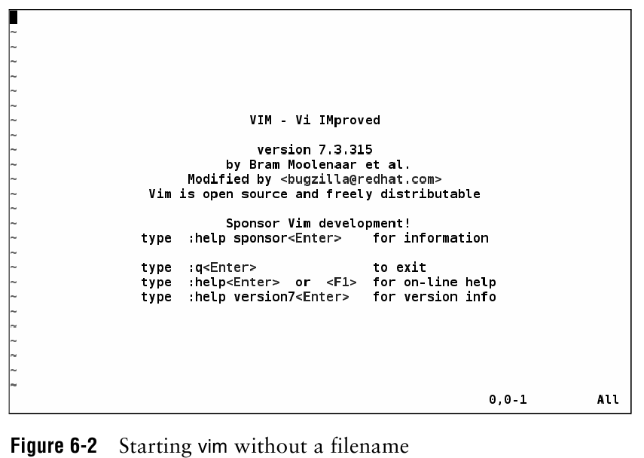

Slide 4
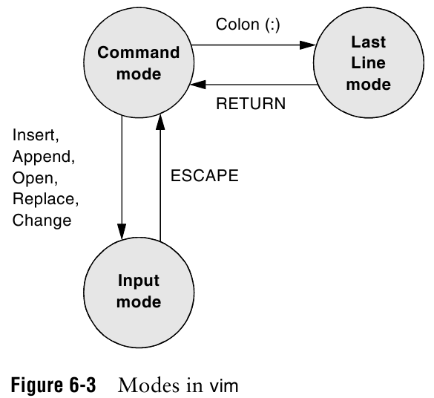

Slide 5
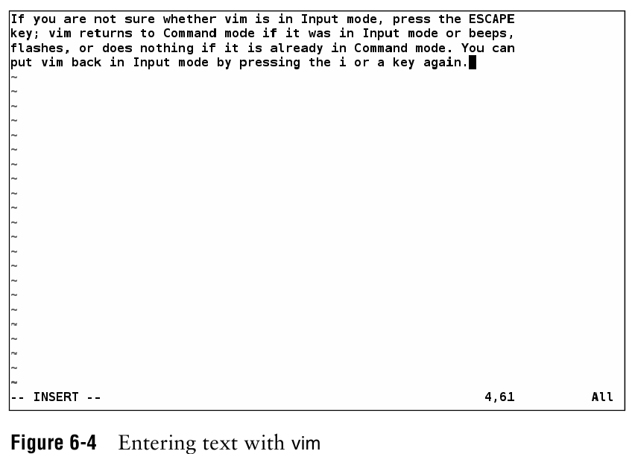

Slide 6
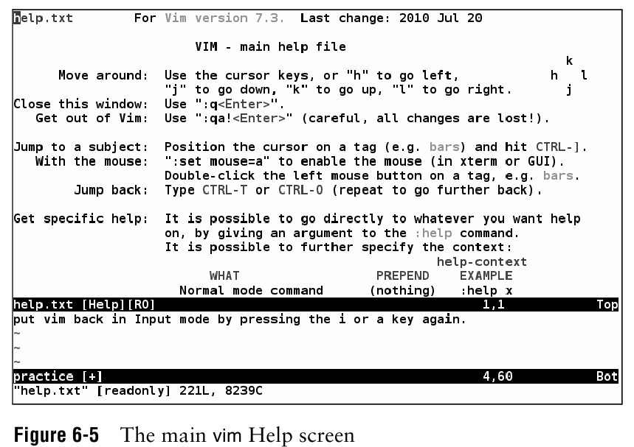
Notes:
:help

Slide 7
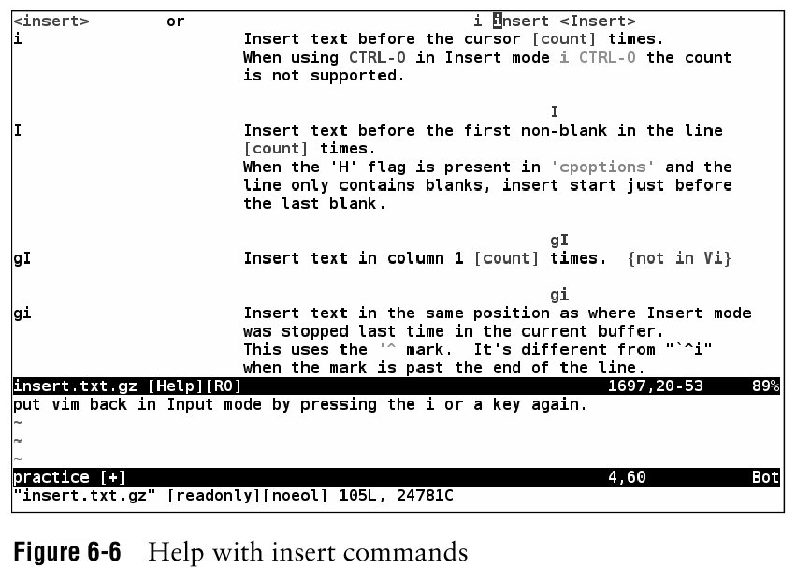
Notes:
:help insert
:q to quit from help

Slide 8
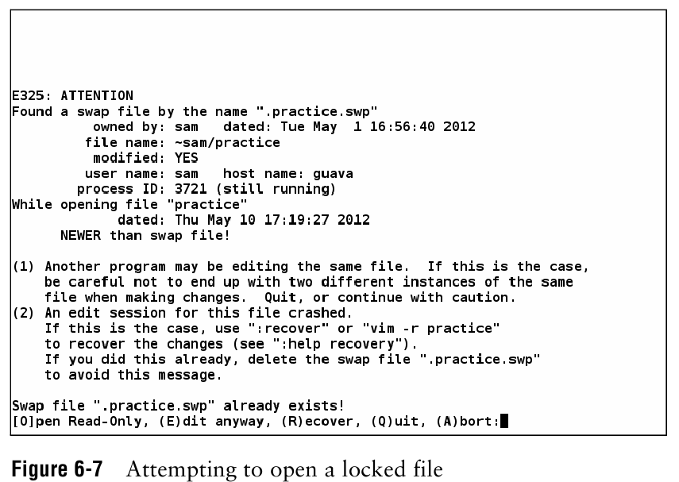
Notes:
Open a file to edit, it is locked.
If file is opened again, this will show up.

Slide 9
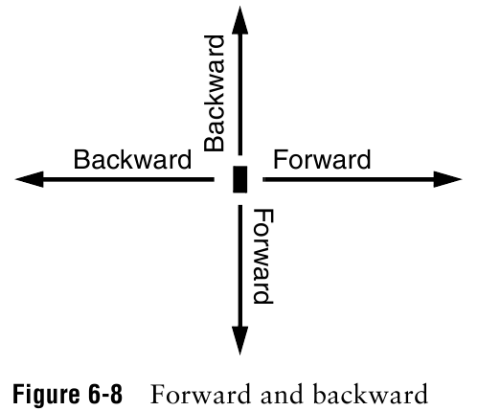

Slide 10
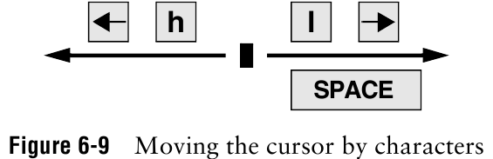
Notes:
Space: forward
h: backward

Slide 11
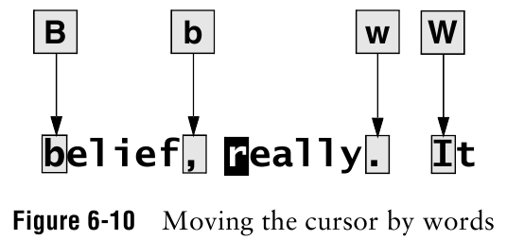
Notes:
b and w: punctuation as word
B and W: blank delimited words

Slide 12
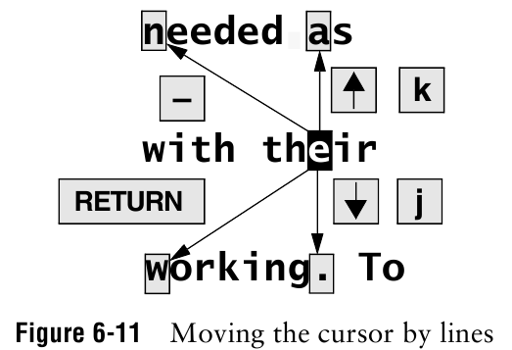
Notes:
- is similar to RETURN but work in the opposite way.

Slide 13
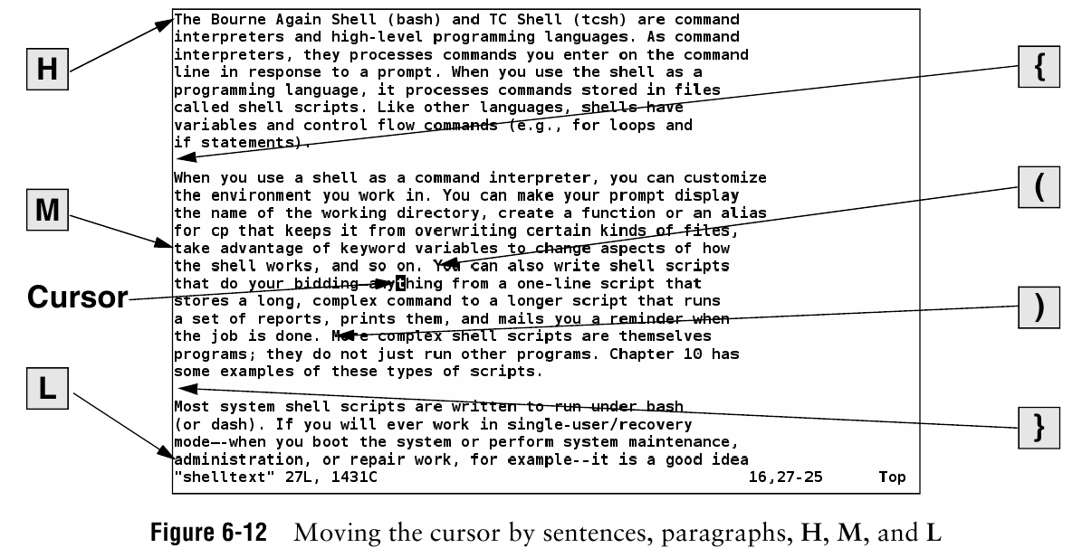

Slide 14
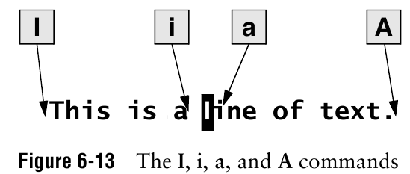

Slide 15
Useful Hot keys
0 : Move to start of line
$ : Move to end of line
G : Jump to last line
V : Visual view, then using arrow up and down to choose multiple lines
D: delete
y: copy
P: paste

Slide 16
Shell Script
A simple program for shell to run
The first line in your script should be:
#!/bin/sh
This says that regardless of the shell the user is running, run this script in bash

Slide 17
Example: Simple shell script
vim hello
#!/bin/sh
echo “Hello $USER”
echo “You are in $PWD”
echo “It has files:”
ls

Slide 18
Running the script “hello”
Running the sample script “hello”
Make sure the script is executable
./hello

Slide 19
Other basics:
$0: Name of the script
$x: command line argument or the script (x is a number)
$4: the fifth argument (including script name)
$#: the number of arguments

